Slide 1
Grade 1

Slide 2
Notes:
Throughout the Common Core State Standards, you will see a focus on reading and writing, an emphasis on 21st Century Skills, an increase in text complexity, and a deeper learning of concepts.

Slide 3
Notes:
In the Literacy Common Core Standards, there will be a focus on critical analysis for students as they use evidence to support their thinking. Vocabulary development will be a focus throughout all grades.

Slide 4
Notes:
Here are the three basic shifts that are seen in grades K-12 in the English Language Arts Common Core Standards.

Slide 5
Notes:
Additional changes in the Literacy Common Core Standards have students spending more time reading and writing as they develop their technical writing skills and recognize unique text structures. In grades K-5 at Cedar Fork, students will be addressing these changes as the classrooms implement the Daily Five model of instruction in literacy. More about that initiative in a minute.

Slide 6
Four strands
1. Reading
Literature
Informational
Foundational Skills
2. Writing
3. Speaking and Listening
4. Language
Notes:
There are four strands throughout the standards.
Let’s begin with Reading. Within the reading strand your child will work on reading and understanding both literary and informational texts. You may know these better as fiction and nonfiction. An additional component of this strand is the Foundational Skills which focuses on developing the phonics skills that will help your child learn how to use their knowledge of letters and sounds to read new words. First grades will also begin to work on developing fluency as they read.
Writing is an equally important strand for students as they begin to put their thoughts, ideas, and evidences on paper. We sometimes say that writing is thinking with a pencil. First graders will work on writing on a topic and providing some facts to support their thinking along with a beginning and ending. Students will also participate in shared writing and research projects with their class.
Speaking and Listening is a new standard that helps our students learn how to participate in conversations and discussions. First graders will learn to ask questions to clarify their understanding of a topic, describe people, places, or things with clarity and in complete sentences.
Language includes both conventions of standard written and spoken English as well as vocabulary development and understanding. First graders will begin to use the conventions of standard English in both their speaking and writing. Some typical conventions that first graders should use include using capital letters for names and dates, using commas in a series, writing simple and compound sentences, and using appropriate ending punctuation. Students should also begin using context clues and other word parts to determine the meaning of unknown words. Students will also begin learning to think about the nuances of words and their meanings like look and peek.

Slide 7
The big ideas
Describing characters, settings, and major events in a story using details
Knowing and using key text features to read and understand informational text
Comparing and contrasting adventures and experiences of characters in texts
Notes:
The big ideas in first grade include:
Describing the characters, settings, and major events in a story by using details from the story. Students will learn to refer back to the text read or heard to support their thinking.
As students read more informational text (or nonfiction) they will become familiar with text features that will help them in their understanding. Text features that first graders will learn about include headings, tables of content, glossaries, electronic menus, and icons.
First graders will also be asked to compare and contrast characters’ adventures or experiences within a text. For example, how do two different characters react to the same event.

Slide 8
The big ideas
Writing narratives, opinion pieces, and informational text including some details with a beginning and end
Participating in conversations and discussions to clarify understanding
Exploring the nuances of meanings in developing their vocabulary
Notes:
The big ideas in first grade include:
First graders will also write every day. They will write stories but they will also write opinion pieces as well as informational pieces. As they write, they will use details to support their thinking and will make sure that they include a beginning and end to the piece. Students will work with their teacher to complete brief research projects.
Students will also learn to participate in conversations and discussions as another way of gathering information and clarifying understanding.
Finally, first graders will continue to learn and use the conventions of standard English in both their writing and speaking but they will also begin the exploration of the nuances of word meaning to expand their vocabulary. They will discuss how look and peek are similar but portray different images.
Here are a few of the vocabulary words that we will be using first quarter -

Slide 9
Notes:
The Mathematics Common Core Standards contain more focus, coherence, and rigor than our past curriculum.

Slide 10
Notes:
In Mathematics, we have two sets of standards: Content and Practice. The Standards for Mathematical Content will focus on WHAT students are learning. The Standards for Mathematical Practice will focus on HOW students are learning.

Slide 11
Content Standards
Instructional time will focus on four critical areas:
Developing understanding of addition, subtraction, and strategies for addition and subtraction within 20
Developing understanding of whole number relationships and place value, including grouping in tens and ones
Developing understanding of linear measurement and measuring lengths as iterating length units
Reasoning about attributes of, and composing and decomposing geometric shapes
Notes:
Critical areas have been identified at each grade level. Although these are not the ONLY skills students are responsible for mastering, it does focus the work at each grade
Here are a few of the vocabulary words from our first quarter standards -

Slide 12
Standards for Mathematical Practice
Standards for Mathematical Practice include:
Make sense of problems and persevere in solving them
Reason abstractly and quantitatively
Construct viable arguments and critique the reasoning of others
Model with mathematics
Use appropriate tools strategically
Attend to precision
Look for and make use of structure
Look for and express regularity in repeated reasoning
Notes:
The practice standards are the same K-12, providing a coherent vision to be applied to the teaching and learning of the mathematical content standards.
Standards for Mathematical Practice describe the characteristics and habits of mind that all students who are mathematically proficient should be able to exhibit.

Slide 13
Notes:
The NC Essential Standards in Science and Social Studies are research based and internationally benchmarked. There are fewer standards but they are more rigorous.

Slide 14
Notes:
You will see less focus on the recalling of facts and more focus on critical thinking in science and social studies.

Slide 15
Notes:
In the classroom, there will be an increase in the use of instructional technology and the use of primary and secondary sources. As a result of the work of the PTA last year and the generous gifts of all of our parents, each classroom is equipped this year with an document camera, LCD projector, Mimeo board, and a new laptop. This equipment will be a tremendous resource as we make these changes to our instructional program.

Slide 16
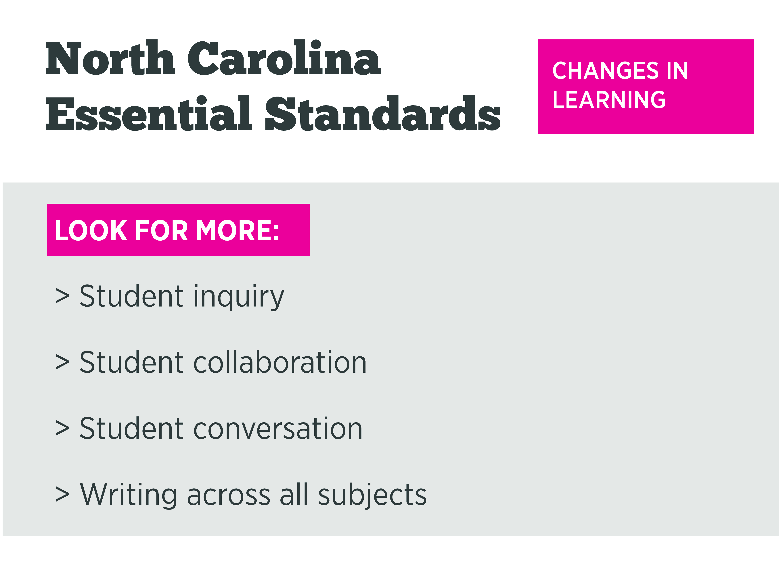
Notes:
Students learning will see changes this year as we increase the amount of student inquiry, collaboration, conversation, and writing across all subjects.

Slide 17
New to social studies is the exploration of
content through five strands.
Five strands include:
History
Geography and Environmental Literacy
Civics and Government
Culture
Economics and Personal Financial Literacy
Notes:
The changes in curriculum will bring about significant shifts in the way that instruction is delivered in the Social Studies classroom. The new curriculum will provide opportunities for students to become more critical thinkers. There will be a greater emphasis on teaching students to make connections and to see the big picture. In doing so, there will be less focus on recalling facts. In many instances, students will investigate collaboratively to grow their learning as well as create work products with the use of instructional technology. Specifically, first graders explore aspects of self, others, families and communities across the world.

Slide 18
Science instruction continues
to be inquiry-based
Areas of Focus:
Balance & Motion
Comparing & Measuring
Organisms
Pebbles, Sand, & Silt
Notes:
With inquiry-based science, instruction begins with open-ended questions or demonstrations. Students do experiments or collect data and take a “hands-on” approach to science. They experience science rather than merely read about it. First graders will explore balanced and unbalanced forces. They will practice measurement with nonstandard units, such as paperclips, blocks, and toothpicks. They will build and observe aquatic and terrestrial habitats to explore the needs of living things. First graders will also learn about Earth materials through collecting and sorting rocks as well as mixing soil and water.

Slide 19
Notes:
Changes in instruction and learning also bring about changes in assessment. Look this year for more open ended questions, technology, and real world applications in our assessments. Teachers will use more informal and formal checks to make sure students are on track throughout the year.

Slide 20
Cedar Fork Pacing Guides
At the beginning of each quarter, Cedar Fork will post the Common Core and Essential Standards that will be covered for each grade in English Language Arts, Math, Science, and Social Studies.
Look for these on the Cedar Fork Website. Click on Parent Resources, and scroll down to Pacing Guides.
http://cedarfork.weebly.com/pacing-guides.html
Notes:
At the beginning of each quarter, CF will post the Common Core and Essential Standards that will be covered for each grade in English Language Arts, Math, Science, and Social Studies. Share with parents where they are located and what they look like.

Slide 21
Notes:
Here are a few topics that we will cover during our fall parent/teacher conference.

